Slide 1

HTML & CSS
Leaving Certificate Computer Science

Slide 2
Web Design & Development What will we cover in these classes?
What is ‘The Web’ and how does it work?
The Internet. World Wide Web. Client / Server relationships
How are websites made?
Intro to HTML
HTML
The language of the web
CSS
Styling websites
Building a Classwork Portfolio Website.
Bootstrap
Another method to style websites
Assessment
Class 1
Classes 2 & 3
Classes 4 & 5
Class 6
Class 7
Class 8

Slide 3
What is the Internet?
First, we will consider the following:
What is the World Wide Web?
Are they the same thing?
How do websites reach your screen?

Slide 4

The Internet
The Internet is a global network, which allows computers to talk to each other.
https://www.telstra.com.sg/content/dam/shared-component-assets/tecom/networks/global-networks/global-internet/hero-banner.jpg

Slide 5

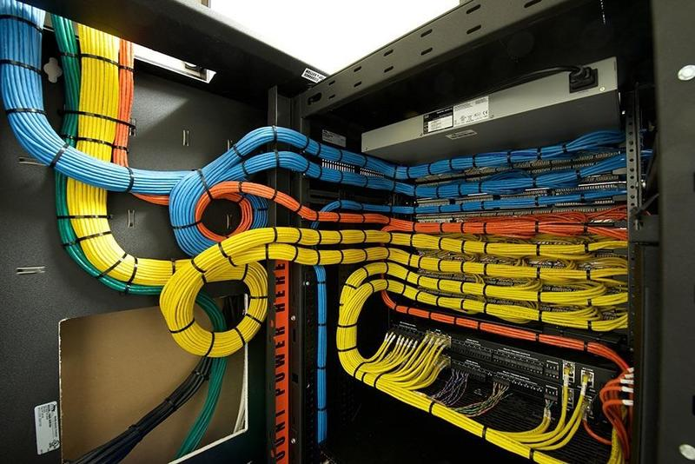

The Internet
It requires hardware and software to operate and allows vast amounts of data to be transmitted over land and under oceans, from one side of the world to the other.
Routers, switches and servers in millions of locations around the globe use over 300 underwater cables and countless cables above ground to connect to each other.

Slide 6
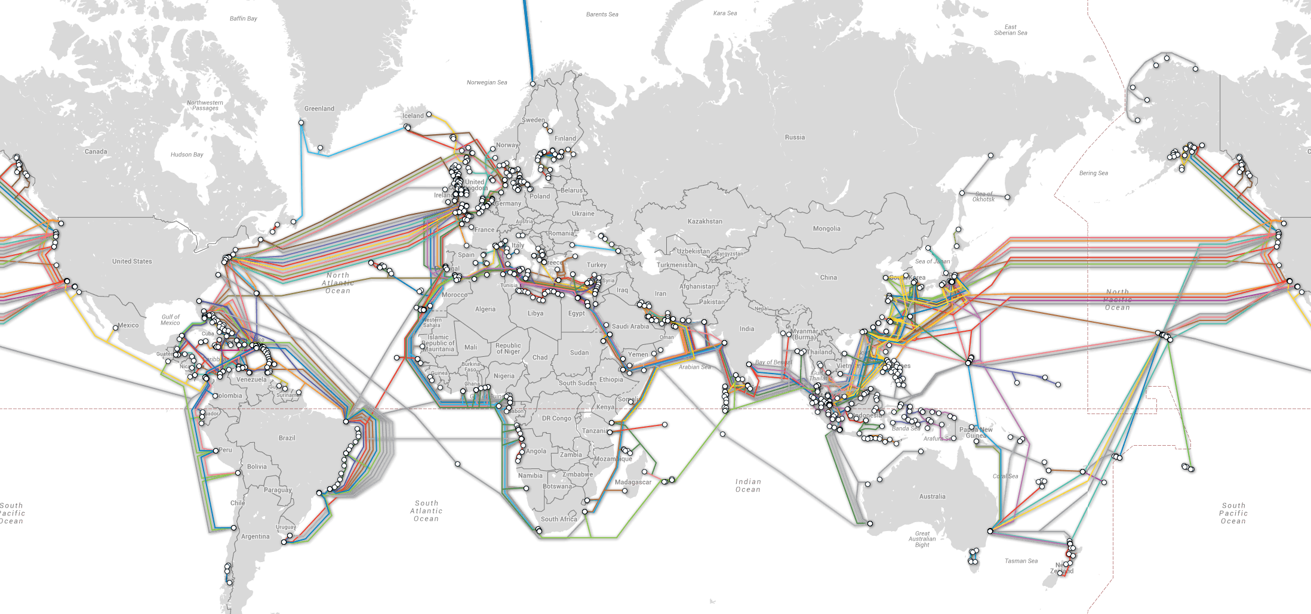
The Internet
If you were to put the underwater cables end to end, they would measure over half a million miles long. (That gets you to the moon and back with enough left over to wrap around the Earth three times!)
All of this cabling, together with wireless networks, link thousands of data centres together, enabling data to be sent and received seamlessly around the world.
https://i.pinimg.com/originals/03/62/25/036225b6f72d6dead644b958b1524d78.png

Slide 7
The Internet
The Internet dates back to 1969 when 2 computers, one at University of California and the other at SRI International in California communicated with each other. Up until this times, computers generally did not share data with another computer, especially in real-time over a live connection.
The Internet now consists of billions of connected devices, all across the world. They are connected in many different ways e.g. copper wires, fibre optic cables, wireless satellites, microwave links and undersea cables.
https://i.pinimg.com/originals/03/62/25/036225b6f72d6dead644b958b1524d78.png

Slide 8
The Internet
The computers connected on the internet are not just normal laptops and computers, but connected sensors and smart devices such as security cameras, TVs, cars and many other household appliances. This is called “The Internet of Things”
We can think of the internet as a network of connected computers i.e. the internet is the network
https://i.pinimg.com/originals/03/62/25/036225b6f72d6dead644b958b1524d78.png

Slide 9
The World Wide Web
The World Wide Web (WWW) is an application that runs on the Internet.
There are many applications and protocols operating on the Internet that provide the services we use every second of every day.
HTTP | HTML
URL | CSS
DNS | Javascript
FTP | Email
For this class, it is not important to know how they all work but it is important to know that they are all individual applications working together to make, ‘the web’ work.

Slide 10
The World Wide Web
The World Wide Web (WWW) uses the Internet as a transmission medium. Without the Internet, the Web wouldn’t work.
The web was invented by Tim Berners-Lee in 1989. He created a way of putting websites onto the Internet. All these websites together are what is known as the World Wide Web.
Think of the Web as a vast collection of documents (often HTML that represent web sites) with links to each other.
The web is only one use of the Internet. Other uses are email, instant messaging, streaming services etc

Slide 11
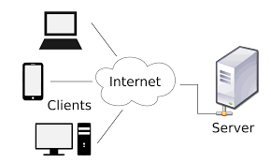
Client Server Relationships
When you visit a web page, your computer (the client) issues a request that eventually makes its way to the appropriate server.
The server is a computer that provides resources or services to other computers.
The server then carries out that request and the information representing the webpage/resources is transmitted back to your computer(the client)
Your browser then renders the information received into the website you see.

Slide 12
Client Server Relationships
Client - Server Model
The WWW application uses the client-server model to communicate.
There are two sides in this model:
Server (a device where data is stored)
Web Server
Email Server
Client (the applications on our phones, tablets & computers)
Internet Browser
Email Application

Slide 13
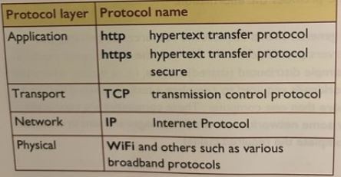
Communication Protocols
A communication protocol is a set of rules describing how to transmit data across a network. This network , can be the internet.
The client server model uses several different protocols, each governing communication in its own protocol layer of the network. Without these protocol (set of rules) the client server model would not work.

Slide 14
The World Wide Web
HTTP – Hyper Text Transfer Protocol
HTTP is used to give users a way to interact with web resources, such as websites.
Messages are transmitted between our phones or computers and the servers holding the information.
We request information from the server by entering the URL (website address) and the server returns the data in the form of a website to our client (phone, tablet, computer)
HTTPS is the secure version which encrypts all traffic to and from the server.
This has allowed for secure banking and online shopping to become as popular as they are.

Slide 15
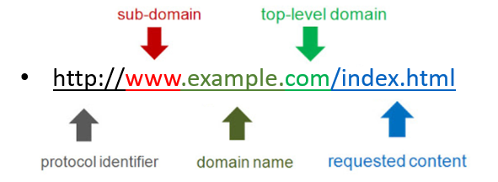
The World Wide Web
URL
URL is an acronym for Uniform Resource Locator.
It is a reference to a resource on the Internet
It dictates the structure of the ‘web address’ that we type into a browser.
Each valid URL points to a unique resource such as a HTML page, a CSS document, an image, etc.
 Note: A URL cannot contain spaces

Slide 16
The World Wide Web
DNS – Domain Name System
DNS is a system that translates a website’s IP address to something we can more easily remember.
In the same way that we search for names in your contacts to save us having to remember hundreds of phone numbers, DNS allows us to remember the website’s name and not the unique IP address.
What is easier to remember? 74.125.193.94 or www.google.com

Slide 17
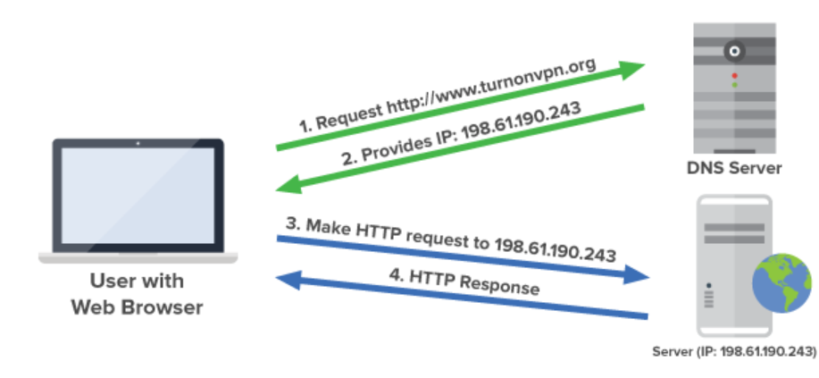
The World Wide Web

Slide 18
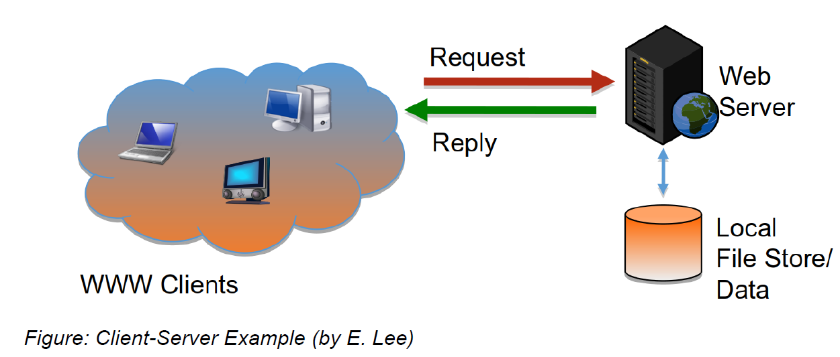
Client Server Relationships
Client - Server Model
For this model it is critically important that the server is powered on and operating at all times. This is called High-Availability
Clients should be able to make a connection at any time, from anywhere and receive the data they request. The client does not need to be powered on 24/7 for the website to work properly.

Slide 19
Summary
You are now familiar with
The Internet
The World Wide Web
The Client Server Model

Slide 21
Web Design & Development What will we cover in these classes?
What is ‘The Web’ and how does it work?
The Internet. World Wide Web. Client / Server relationships
How are websites made?
Intro to HTML
HTML
The language of the web
CSS
Styling websites
Building a Classwork Portfolio Website.
Bootstrap
Another method to style websites
Assessment
Class 1
Classes 2 & 3
Classes 4 & 5
Class 6
Class 7
Class 8

Slide 22
How are websites made?
HTML – Hyper Text Mark-up Language
The Web was created by Tim Berners-Lee whilst he was working at CERN.
He created the HTML language in 1991 whilst trying to find a better way to share information between sites, which until then relied on physically moving documents between sites or downloading entire documents when only a small portion of it was required. HTML allowed researchers to simply click on a hyperlink and navigate to a different document and view the desired content.
HTML revolutionised how information was shared, first at CERN and then globally once the first internet browsers were made available in the early 1990s

Slide 23
How are websites made?
HTML – Hyper Text Mark-up Language
Since the first version of HTML was released in 1989, vast improvements have been made. We have come a long way from the initial “text only” websites to what we now see when browsing the web.
Image tags were first used in 1993 allowing for images and photographs to be used on websites. Until this happened, the web was text only.
CSS and Javascript became available in 1996. This enabled websites to be styled and become interactive
HTML 5 was adopted in 2009, and is the current version being widely used.

Slide 24
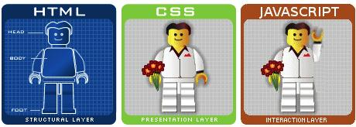
How are websites made?
HTML is the basis on which everything on the web is built. Without it our computers would not know how to present the website on screen.
CSS allows for the bare-bones, text only HTML websites to be styled and made more presentable. This enhances the experience for the user and ensures websites are presented well on small, mobile devices.
Javascript enables users to interact with the website. The website can dynamically change based on your interaction with it thanks to Javascript.

Slide 25
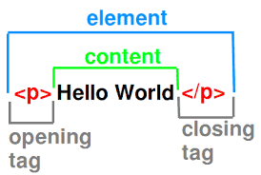
How are websites made?
So what does HTML look like?
Many different tags are used throughout a HTML document to produce text differently on screen.
Usually, there will be a starting tag and a closing tag. In the example above <p> is the opening tag and </p> is the closing tag.
The text “Hello World” is the only thing that would be displayed on the screen in this example.

Slide 26
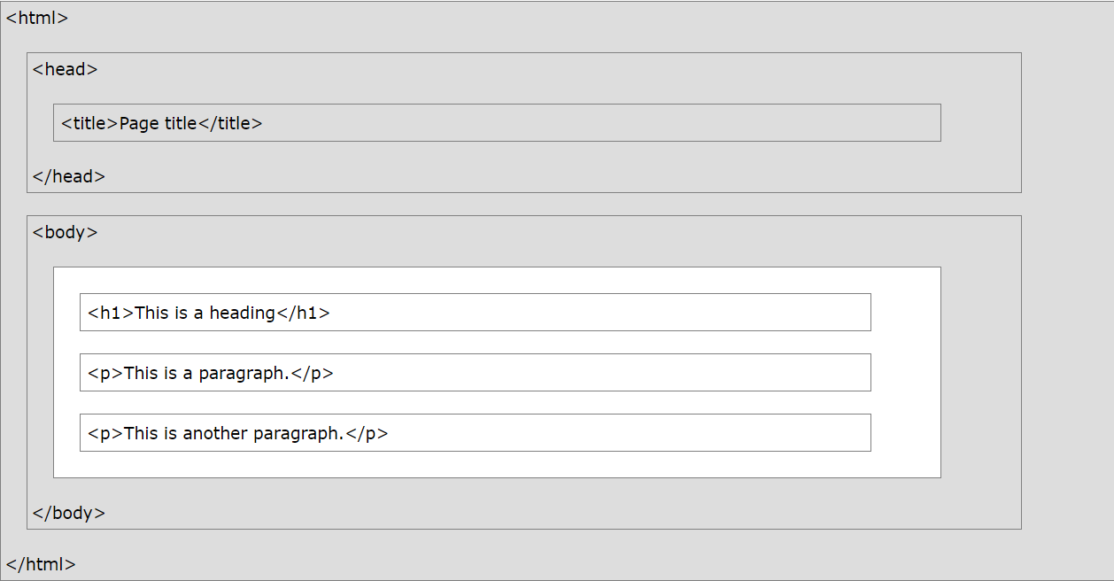
How are websites made?
<!DOCTYPE html> <html> <head> <title>Page Title</title> </head> <body> <h1>This is a heading</h1> <p>This is a paragraph.</p>
<p>This is another paragraph.</p>
</body> </html>
A closer look at a HTML document.
Only the text in the <body> i.e. the white section will appear on screen. Everything else relates to the structure of the HTML document.
Figure: HTML examples (https://www.w3schools.com/html/html_intro.asp)

Slide 27
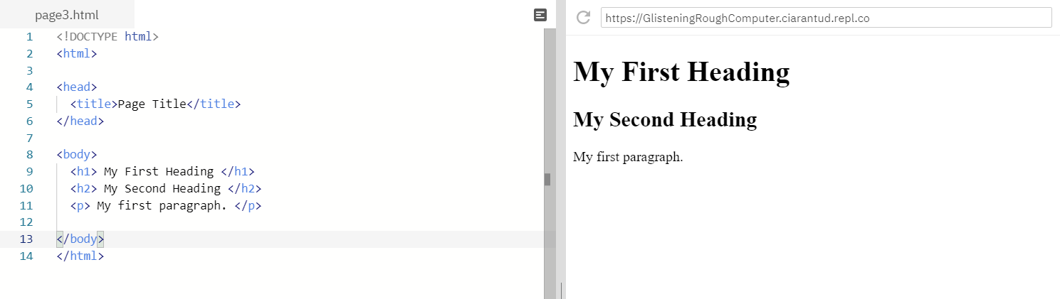
How are websites made?

Slide 28
Summary
You have now seen how to display text on a webpage by
Adding a h1 element to the body of a html file
Adding a p element to the body of a html file

Slide 30
Web Design & Development What will we cover in these classes?
What is ‘The Web’ and how does it work?
The Internet. World Wide Web. Client / Server relationships
How are websites made?
Intro to HTML
HTML
The language of the web
CSS
Styling websites
Building a Classwork Portfolio Website.
Bootstrap
Another method to style websites
Assessment
Class 1
Classes 2 & 3
Classes 4 & 5
Class 6
Class 7
Class 8

Slide 31
HTML – Hyper Text Markup Language
The language of the web
<!DOCTYPE html> <html> <head> <title>Page Title</title> </head> <body> <h1>This is a heading</h1> <p>This is a paragraph.</p>
<p>This is another paragraph.</p>
</body> </html>
Only the text in the <body> element, i.e. the white section above, will appear on the webpage. Everything else relates to the structure of the HTML document.
Figure: HTML examples (https://www.w3schools.com/html/html_intro.asp)

Slide 32
HTML – Hyper Text Markup Language
The language of the web
Only the text in the <body> element, i.e. the white section above, will appear on the webpage. Everything else relates to the structure of the HTML document.
Figure: HTML examples (https://www.w3schools.com/html/html_intro.asp)

Slide 33
Review: What makes up a HTML element?
Many different tags are used throughout a HTML document to produce text differently on screen.
Most of the time there will be a starting tag and a closing tag.
The ‘element’ is the whole piece which contains
Opening tag
Content
Closing tag

Slide 34
Sections within HTML document
All html files must follow this structure
There are four main sections of any HTML document that must exist for the webpage to operate correctly.
The <!DOCTYPE> declaration
The <html> element
The <head> element
The <body> element
Can you identify each section in our Google example?

Slide 35
<!DOCTYPE> tag
The <!DOCTYPE> declaration:
Represents the document type.
Helps the browser display web pages correctly.
Must only appear once, at the top of the HTML document, before any HTML tags.
Not case sensitive.
The <!DOCTYPE> declaration for HTML5 is shown below.
<!DOCTYPE html>

Slide 36
<html> tags
<!DOCTYPE html>
<html>
<head>
meta, title, link tags
</head>
<body>
<h1> Heading 1 </h1>
<h2> Heading 2 </h2>
<h3> Heading 3 </h3>
<h4> Heading 4 </h4>
<h5> Heading 5 </h5>
<h6> Heading 6 </h6>
</body>
</html>
The <html> & </html> tags:
bookend the HTML document
represent the root of the HTML document
form a container for all other HTML elements, (with the exception of the <!DOCTYPE> tag)

Slide 37
<head> tags
The <head> & </head> tags contain the metadata for the HTML document.
Metadata is data about the HTML document.
Metadata typically define the
document title
character set
styles
scripts
<!DOCTYPE html>
<html>
<head>
<meta charset="utf-8">
<meta name="viewport“ content="width=device-width">
<title>repl.it</title>
<link href="style.css" rel="stylesheet" type="text/css" />
</head>
<body>
webpage content
</body>
</html>

Slide 38
<head> tags
Some of the common elements that are included within the head tag include:
<title>: This element is used to define the title of the document, which is displayed in the browser's title bar and is often used by search engines to describe the page.
<meta>: This element is used to define metadata about the document, such as the character encoding, description of the page, keywords, and author.
<link>: This element is used to link to external resources, such as stylesheets or scripts, that are used to format or enhance the page.
<script>: This element is used to define JavaScript code that is executed on the page.

Slide 39
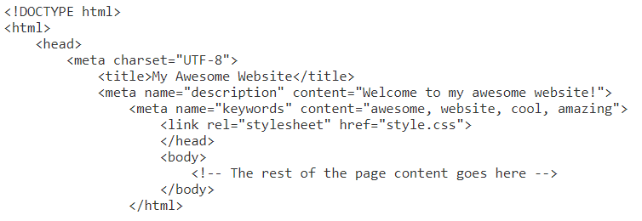
Example of a head tag:
In this example, the code specifies the character set, sets the page title to "My Awesome Website," provides a brief description of the website, lists some keywords that describe the content, and includes a link to a CSS stylesheet that controls the page's styling.

Slide 40
<body> tags
The <body> & </body> tags define the document’s body section.
The <body> element contains all of the content of the HTML document.
headings
paragraphs
images
hyperlinks
lists
There can only be one <body> element in a HTML document.
<!DOCTYPE html>
<html>
<head>
meta, title, link tags
</head>
<body>
<h1> Heading 1 </h1>
<h2> Heading 2 </h2>
<p> paragraph 1 </p>
<p> paragraph 2 </p>
<img src="image.jpg">
<a href="https://www.csinc.ie">This is a link</a>
<ol> ordered list
<li> list item </li>
</ol>
</body>
</html>

Slide 41
Heading tags
HTML headings are defined using the following opening and closing tags:
<h1> </h1> Most Important heading. Largest.
<h2> </h2>
<h3> </h3>
<h4> </h4>
<h5> </h5>
<h6> </h6> Least Important heading. Smallest.
So what does this look like?

Slide 42
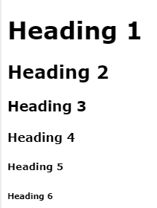
Heading tags
<body>
<h1> Heading 1 </h1>
<h2> Heading 2 </h2>
<h3> Heading 3 </h3>
<h4> Heading 4 </h4>
<h5> Heading 5 </h5>
<h6> Heading 6 </h6>
</body>

Slide 43
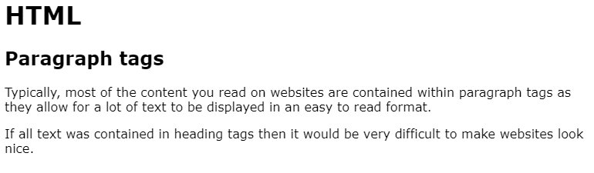
Paragraph tags
<body>
<h1> HTML </h1>
<h2> Paragraph tags </h2>
<p> Typically, most of the content you read on websites are contained within paragraph tags as they allow for a lot of text to be displayed in an easy to read format. </p>
<p> If all text was contained in heading tags then it would be very difficult to make websites look nice. </p>
</body>
What do they look like in real life?

Slide 44
Lists
We use lists every day of our lives and they come in all shapes and sizes.
Class timetable
TV channel listing
App download charts
Shopping list
Recipe
There are two types of lists though and we don’t tend think about that every time we use them.
Unordered lists
Ordered lists
When do we use each one?
Does it matter what order we buy the items for a recipe when shopping?
Does it matter what order we prepare and cook them when using the recipe?

Slide 45
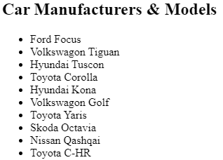
Unordered Lists
<body>
<h2> Car Manufacturers & Models </h2>
<ul>
<li> Ford Focus </li>
<li> Volkswagon Tiguan </li>
<li> Hyundai Tuscon </li>
<li> Toyota Corolla </li>
<li> Hyundai Kona </li>
<li> Volkswagon Golf </li>
<li> Toyota Yaris </li>
<li> Skoda Octavia </li>
<li> Nissan Qashqai </li>
<li> Toyota C-HR </li>
</ul>
</body>

Slide 46
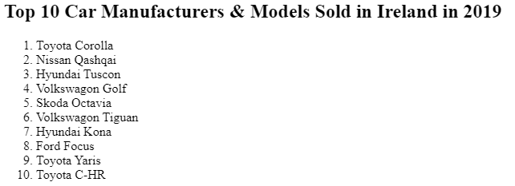
Ordered Lists
<body>
<h2> Top 10 Car Manufacturers & Models Sold in Ireland in 2019 </h2>
<ol>
<li> Toyota Corolla </li>
<li> Nissan Qashqai </li>
<li> Hyundai Tuscon </li>
<li> Volkswagon Golf </li>
<li> Skoda Octavia </li>
<li> Volkswagon Tiguan </li>
<li> Hyundai Kona </li>
<li> Ford Focus </li>
<li> Toyota Yaris </li>
<li> Toyota C-HR </li>
</ol>
</body>

Slide 47
Summary
You are now familiar with
The structure of every HTML 5 document
Adding text to a webpage using paragraph and heading tags
Creating unordered lists and adding list items to the list
Creating ordered lists and adding list items to the list

Slide 49
What will we cover in this class?
Hyperlinks
What are they?
How do they work?
Linking to other pages in our website
Linking to external websites
Images
Why are images important?
Using the images folder
Inserting images into our webpages

Slide 50

Why use images in HTML?
There’s a big difference in a website that is heavily text based and a website that has a good blend of imagery and text.
Text heavy websites have their place and suit certain purposes (Wikipedia for example)
However, most people would be put off from browsing text based websites for fun, or for a long period of time.
Whilst Wikipedia articles will provide you with useful information, they don’t tend to grab your attention or keep you engaged.
Let’s look at how important good use of imagery is within HTML.
Image Source: https://pixabay.comImage

Slide 51
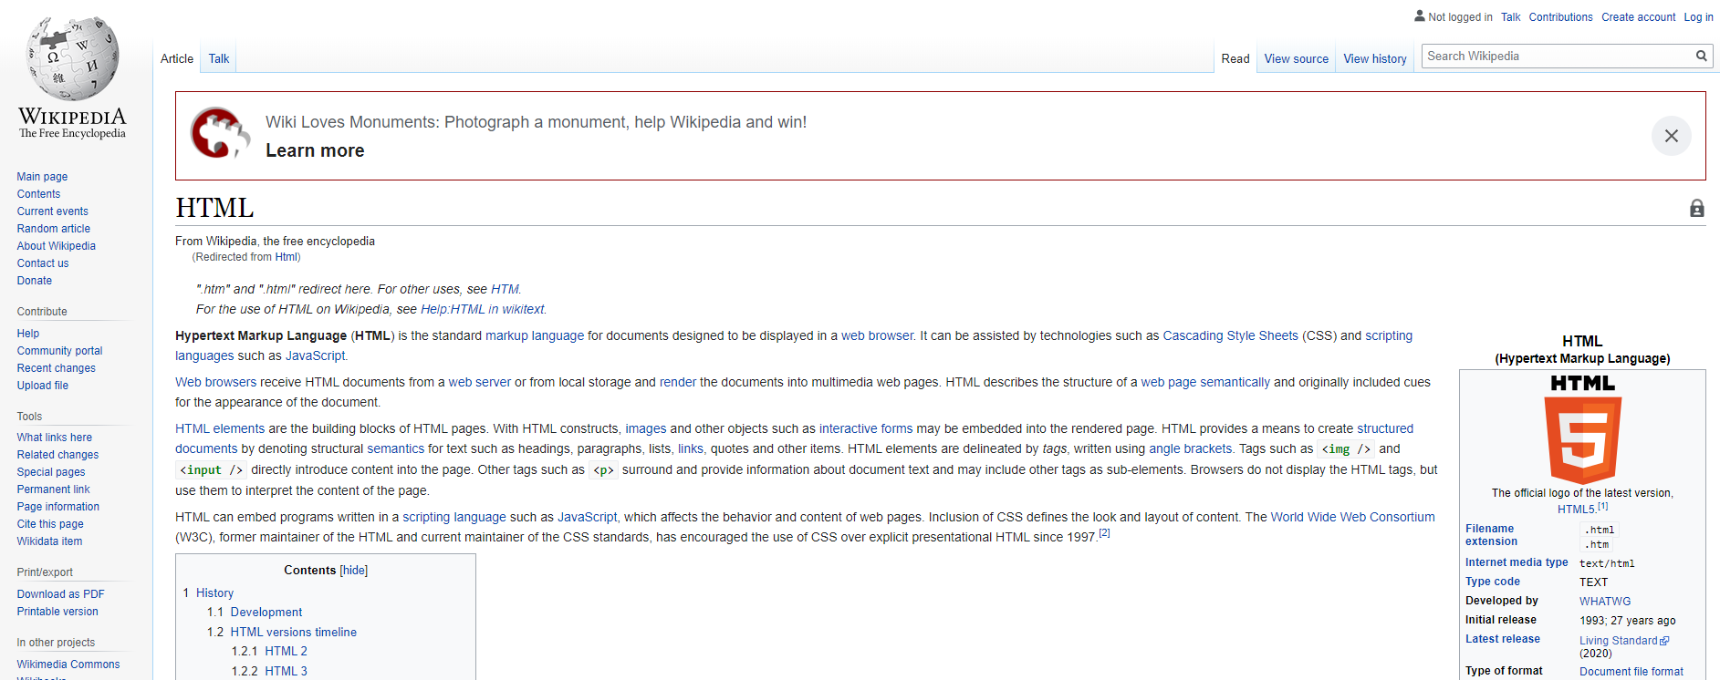
Why use images in HTML?
Whilst the Wikipedia article below will provide you with useful information, it doesn’t grab your attention.
The links require you to read them to know what you are clicking towards.

Slide 52
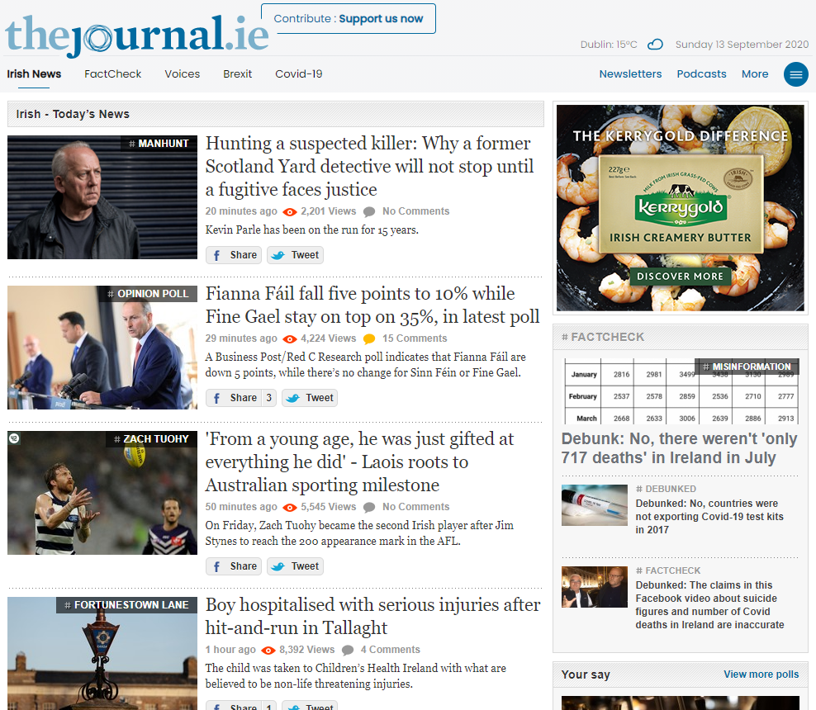
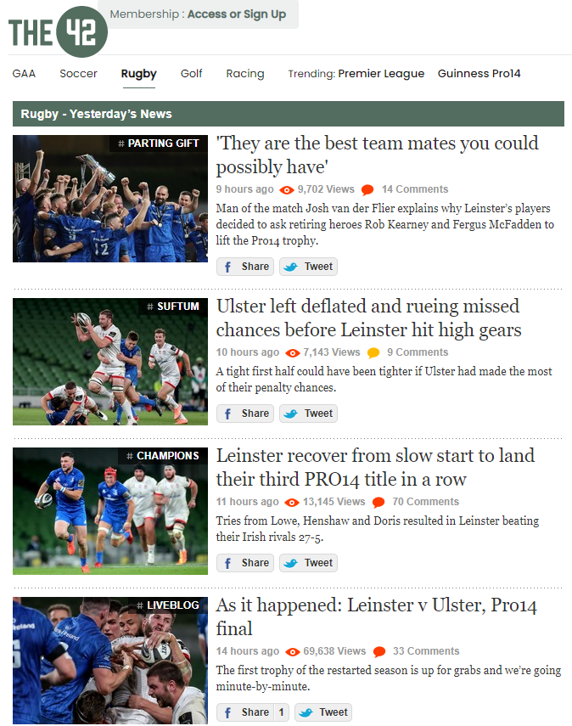
Why use images in HTML?
News sites such as The Journal or The 42 use images within each news headline to help the reader immediately know what the content is about and to also draw the reader’s attention to specific articles of interest to them.

Slide 53
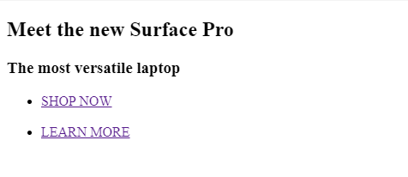
Effective use of images.
What webpage is more likely to grab your attention and make you click the link to hopefully spend money?
This one?

Slide 54
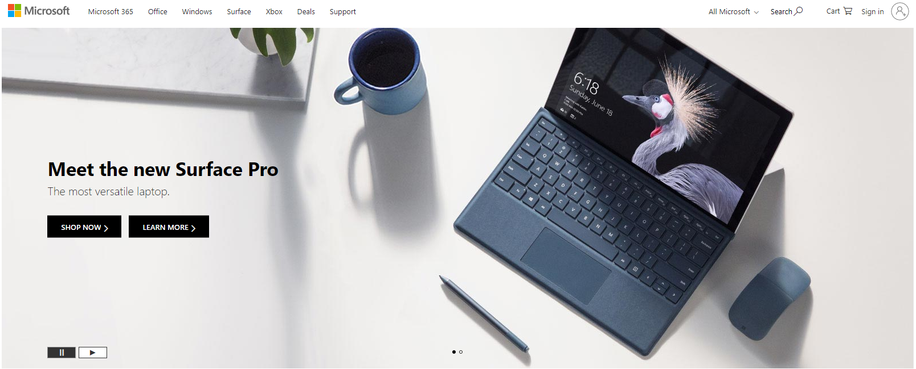
Effective use of images.
Or this one?

Slide 55
Using images in HTML
Best practice is to have an “images” folder where all images contained on the website are housed.
Sub folders for each webpage can be created within the images folder if required.
This allows for
better management of a large number of files
efficient movement between servers during upgrades
The next slide reminds you how to create the images folder in Repl.it
We will then look at implementing the <img> tag and displaying an image on screen.

Slide 56
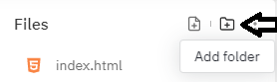

Using the images folder in Repl.it
Navigate to Repl.it and log in to the account you created in the first class.
Create a new Repl, select HTML 5 as the language and name it “Class 3 – Images”.
On the left hand menu, click the Add Folder button.
Click Add Folder.
Name the folder images and hit the return key.
Download the sample images from the folder in the Class 3 section of Moodle.
Open your browser window and then open the folder where the images downloaded to.
Highlight the images and click and drag them into the images folder.
Please use the video tutorial detailing this process if you need assistance – 3.8 Images Folder Tutorial

Slide 57
Using images in HTML
The image element <img> is unlike the other tags and elements we have looked at so far as it does not require a closing tag.
It has three components
The image tag
The source attribute
The alt attribute
Let’s see how it looks in action.
<img src="images/CSinc.png" alt="CS Inc logo">

Slide 58
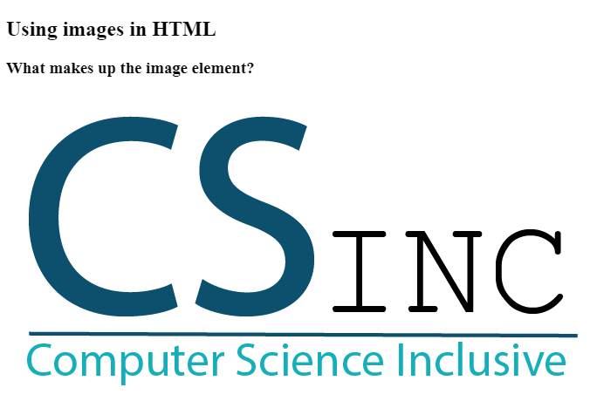
Using images in HTML
<!DOCTYPE html>
<html>
<head>
<meta charset="utf-8">
<meta name="viewport" content="width=device-width">
<title>Using Images</title>
<link href="style.css" rel="stylesheet" type="text/css" />
</head>
<body>
<h2> Using images in HTML </h2>
<h3> What makes up the image element? </h3>
<img src="images/CSinc.png" alt="CS Inc logo">
</body>
</html>

Slide 59
Using images in HTML
If we break down the line of code relating to the image, we can clearly see the three components we saw in the previous slide.
<img src="images/CSinc.png" alt="CS Inc logo">
The image tag <img >
The source attribute src="images/CSinc.png"
The alt attribute alt="CS Inc logo">
This is the basis for inserting any image into any HTML document.

Slide 60
The source attribute
<img src="images/CSinc.png" alt="CS Inc logo">
The source attribute src="images/CSinc.png"
If you run into problems displaying an image on your webpage, it is highly likely that the source attribute is incorrect.
If we break down the code in the example above, we can see that we are linking the source attribute to
The ‘images’ sub-folder
A file called ‘CSinc.png’
If we linked to Csinc.png or Csinc.jpg or images\Csinc.png then no image would be displayed.
It is essential that the filename is identical to the filename stored in the images folder.

Slide 61
The alt attribute
<img src="images/CSinc.png" alt="CS Inc logo">
The alt attribute alt="CS Inc logo"
The alt attribute allows you to enter alternate text describing the image. You can see we are telling the user that the CS Inc logo is being displayed.
This is used for images that won’t load due to a bad internet connection, an error in the source attribute or for users that use a screen reader.
Search engines also look favourably on websites that use the alt attributes correctly and rank the website higher as a result.
This falls into an aspect of the web called Search Engine Optimisation (SEO) but is outside the scope of this course.

Slide 62
Summary
You are now familiar with
Storing any picture files in an images folder
Using the <img> tag with the src and alt attributes to add an image to your webpage

Slide 64
The Web What will we cover in these classes?
What is it and how does it work?
The Internet. World Wide Web. Client / Server relationships
How are websites made?
Intro to HTML
HTML
The language of the web
CSS
Styling websites
Embedding code within webpages
Bootstrap
Another method to style websites
Assessment
Class 1
Classes 2 & 3
Classes 4 & 5
Class 6
Class 7
Class 8

Slide 65
Review: What did we cover in the last class?
Sections of the HTML document. Content can be different in every file Structure must remain the same. | Tags - Structure !DOCTYPE HTML Head Body
Tags - Content Headings Paragraphs Lists | Ordered & Unordered Lists Ordered Lists are numbered Unordered Lists are bulleted They are both made up of list items

Slide 66
What will we cover in this class?
Hyperlinks
What are they?
How do they work?
Linking to other pages in our website
Linking to external websites
Images
Why are images important?
Using the images folder
Inserting images into our webpages

Slide 67
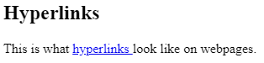
Hyperlinks - What are they?
Hyperlinks are links that are embedded in the text of a webpage that allow you to click on them and navigate to:
a different part of the webpage you’re on (not covered in this class)
a new page within the website you’re visiting
a new website entirely.

Slide 68
Hyperlinks - What are they?
Without the ability to easily jump between pages or websites, the web would never have become what it is today.
The manual entering of URLs or scrolling through large webpages to find a particular section would prevent most people from using it.
So how do we create them?

Slide 69
Hyperlinks – How do they work?
The <a> tag defines a hyperlink. The href attribute specifies the URL of the page the link goes to:
<a href="https://www.w3schools.com">Visit W3Schools</a>
The source is the text, image, or button that links to another resource.
The blue hyperlinks link in the example below.
The destination is the resource that the source anchor links to.
The http://www.csinc.ie link in the example below.
<h2> Hyperlinks </h2>
<p> This is what
<a href="http://www.csinc.ie"> hyperlinks </a> look like on webpages. </p>

Slide 70
Hyperlinks – Let’s break them down
<a href="http://www.csinc.ie"> hyperlinks </a>
The anchor element uses an opening and closing tag.
The opening tag <a> incorporates the destination link
The closing tag </a> is essential and its location is very important.
It should be placed directly after the text you want to be ‘clickable’ otherwise the link will use the rest of the text on the page until it appears.
href stands for ‘hyperlink reference’ and is where you set the URL or page name you want to direct the user to.
Two examples of anchor tags applied in different locations of the HTML document are shown on the next slides. Both of them direct the user to a new website.

Slide 71
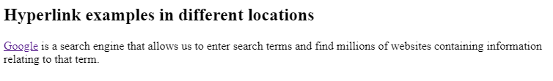
Hyperlinks – linking to a new website
HTML containing anchor tags at the start of a paragraph.
<h2> Hyperlink examples in different locations </h2>
<p> <a href="http://www.google.ie"> Google</a> is a search engine that allows us to enter search terms and find millions of websites containing information relating to that term. </p>
Hyperlink on webpage.

Slide 72
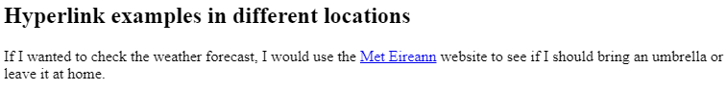
Hyperlinks – linking to a new website
HTML containing anchor tags in the middle of a paragraph.
<h2> Hyperlink examples in different locations </h2>
<p> If I wanted to check the weather forecast, I would use the
<a href="http://www.met.ie"> Met Eireann</a> website to see if I should bring an umbrella or leave it at home. </p>
Hyperlink on webpage.

Slide 73
Hyperlinks – linking internally
We don’t always have to link to a new website and leave the one we are already on.
Maybe we want to find out some information relating to the website we are on such as, contact details for a department or directions to a particular building.
In this case, we don’t use a URL in our source anchor tag for a different website, we use the page name for the relevant page on our website.
In Repl, we can create new HTML pages, enter new content and link to them from the index.html page we set up a few weeks ago.
This allows us to create a website containing multiple pages, have different content on each page and link between them. This leads to a much better user experience (also known as UX).

Slide 74
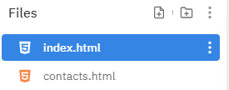
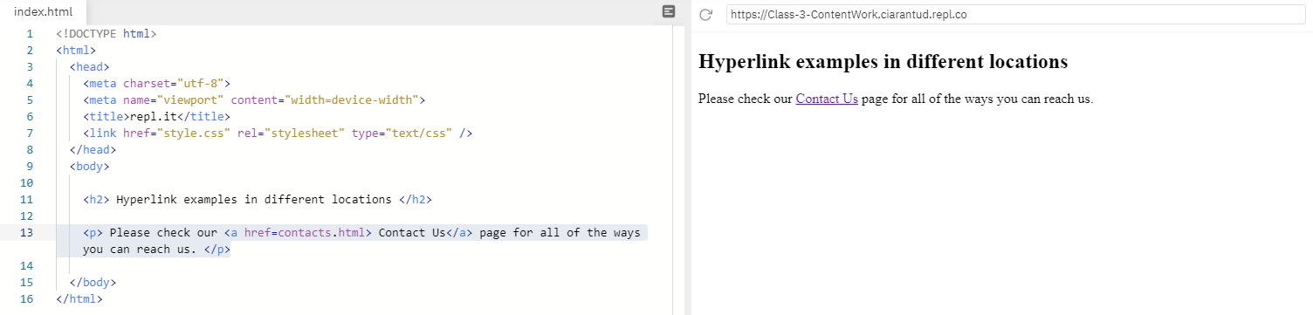
Hyperlinks – linking internally
In Task 1 we will step through how to add pages and link between them.
For now you can see the example below showing two HTML pages.
The image below shows our index page with a link to the Contact Us page. Let’s click it.

Slide 75
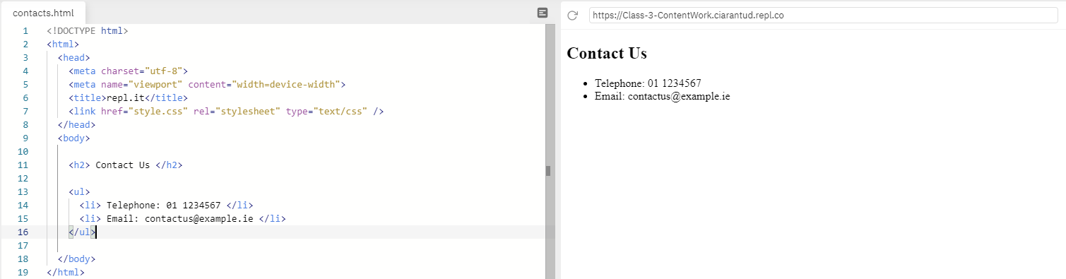
Hyperlinks – linking internally
We are brought to the Contact Us page of the website, which is shown on the right.
The HTML code making up this page is shown on the left.
The structure is the very same. The only difference is the <body> section containing the content to be displayed.

Slide 76
Recap
Hyperlinks allow us to link to a new page or new website entirely.
They require a source anchor and destination anchor to be specified.
They appear as clickable text within the webpage.
They can also be embedded into images to create a clickable image that will bring us to the new page or website.
Let’s look at how to uses images in HTML now.

Slide 77
The Web What will we cover in these classes?
What is it and how does it work?
The Internet. World Wide Web. Client / Server relationships
How are websites made?
Intro to HTML
HTML
The language of the web
CSS
Styling websites
Embedding code within webpages
Bootstrap
Another method to style websites
Assessment
Class 1
Classes 2 & 3
Classes 4 & 5
Class 6
Class 7
Class 8

Slide 78
Summary
You are now familiar with
Using the <a> anchor tag so create a hyperlink to another website
Using the <a> anchor tag so create a hyperlink to another webpage in the current website

Slide 80
The Web What will we cover in these classes?
What is it and how does it work?
The Internet. World Wide Web. Client / Server relationships
How are websites made?
Intro to HTML
HTML
The language of the web
CSS
Styling websites
Embedding code within webpages
Bootstrap
Another method to style websites
Assessment
Class 1
Classes 2 & 3
Classes 4 & 5
Class 6
Class 7
Class 8

Slide 81
Review: What did we cover in the HTML classes?
Sections of the HTML document. The content of each webpage can be different but the structure must remain the same. | Tags - Structure !DOCTYPE HTML Head Body | Tags - Content Headings Paragraphs Lists
Anchor links Source anchor Destination anchor | Linking to other pages in website Linking to external websites | Images Images folder Proper use of the source attribute to reference and link to the relevant image file

Slide 82
What will we cover in this class?
CSS
What is it?
What does it do?
How does it work?
What can we change?
What does it look like?
Ways to implement CSS
Using CSS
Elements
Syntax
Selectors

Slide 83
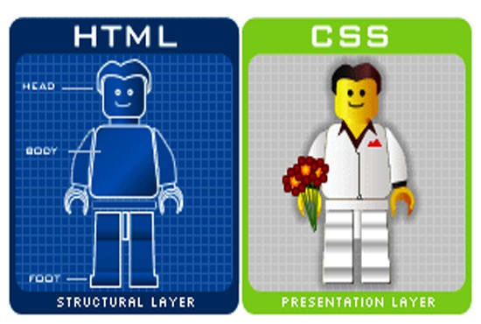
CSS – What is it?
CSS stands for Cascading Style Sheets. It is a method used to style websites.
CSS is used to change aspects of HTML documents such as background colour, font colour, font size & page layout.
CSS controls how HTML elements are displayed within webpage and websites.
It allows us to define the overall design and layout of our webpages and to cater them for use on devices with different screen sizes.
It also allows for easy and efficient styling of multiple web pages, all at once.
We should remember
HTML dictates the structure
CSS dictates the design

Slide 84
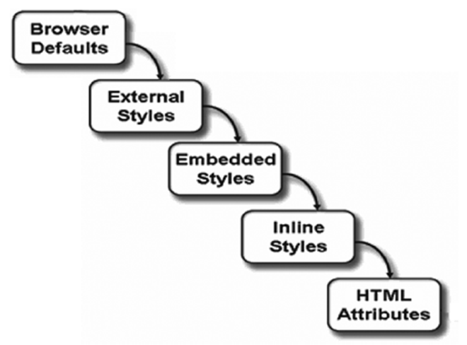
CSS – What is it?
The cascade in the name, “Cascading Style Sheets” describes the order in which styling is applied.
There may be no styling implemented, in which case the browser applies some default styling, or, at the other end of the scale, there may be very specific styling applied to some HTML elements. In this case the HTML attribute styling will override the styling applied before it.
If we look at this diagram, from the top down, we can see the order in which styling will be applied to the HTML document.
The default settings of the browser
External Style Sheets
Embedded Styles
Inline Styling (The type we will look at today)
HTML attribute styling

Slide 85
CSS – What can we change?
Some things that we can change by implementing CSS styling are listed below.
 Note: It is not a full list by any means.
All elements of a webpage can be styled and manipulated, we will look at some basic styling in this class.
Font family
Font size
Font colour
Background colour
Image size
Image position
Text position

Slide 86
CSS – What does it do?
CSS allows us to turn the webpages we have been creating into more visually appealing versions of themselves by
Introducing font styling,
Changing the layout of the page
Making the webpage responsive to screens of different sizes.
The next few slides show how differently a webpage can be styled, just by changing the CSS applied to it.
The content of the HTML document is the same in all examples. All that has changed is the CSS styling.
You can visit the link below to use the interactive example and find more information.
https://www.w3schools.com/css/css_intro.asp

Slide 87
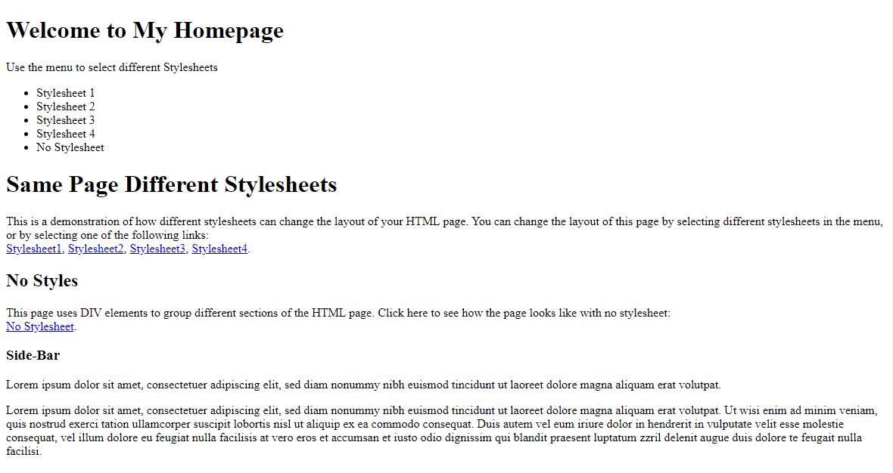
CSS – Webpage – No CSS applied.

Slide 88
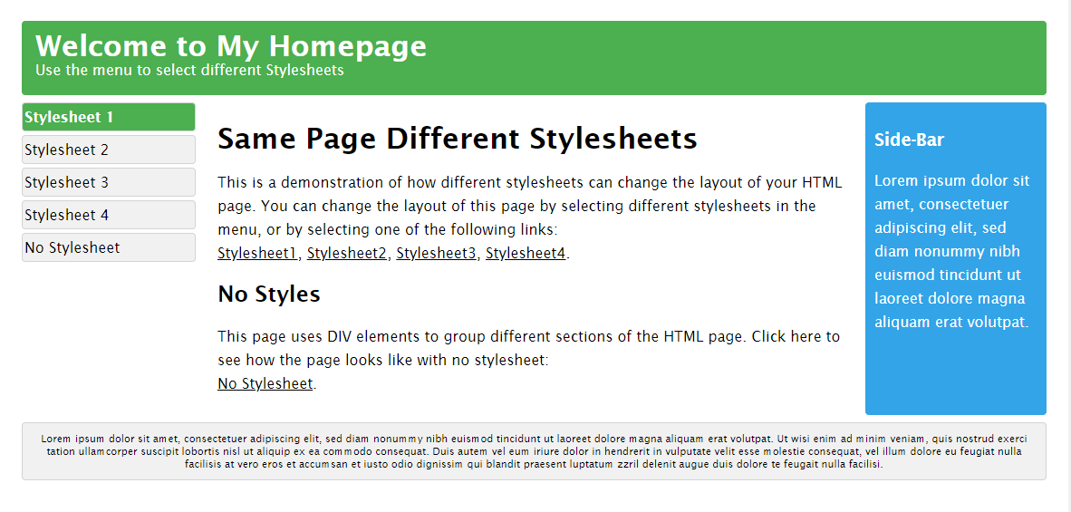
Sample Webpage Styled with CSS

Slide 89
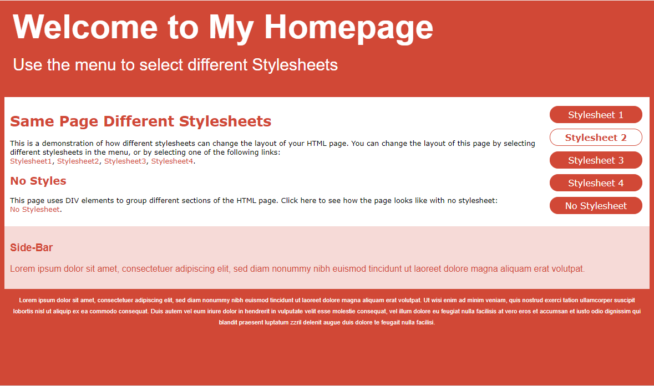
Sample Webpage Styled with CSS

Slide 90
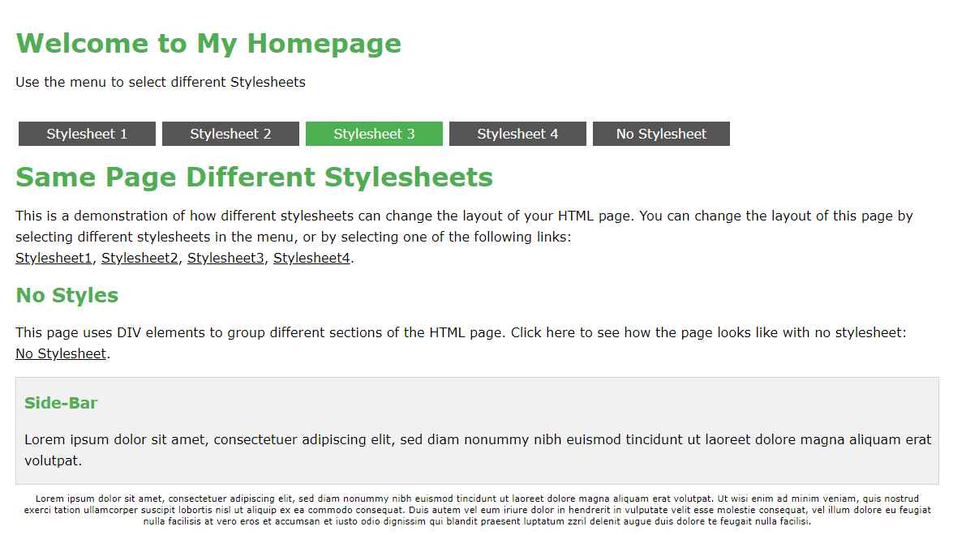
Sample Webpage Styled with CSS

Slide 91
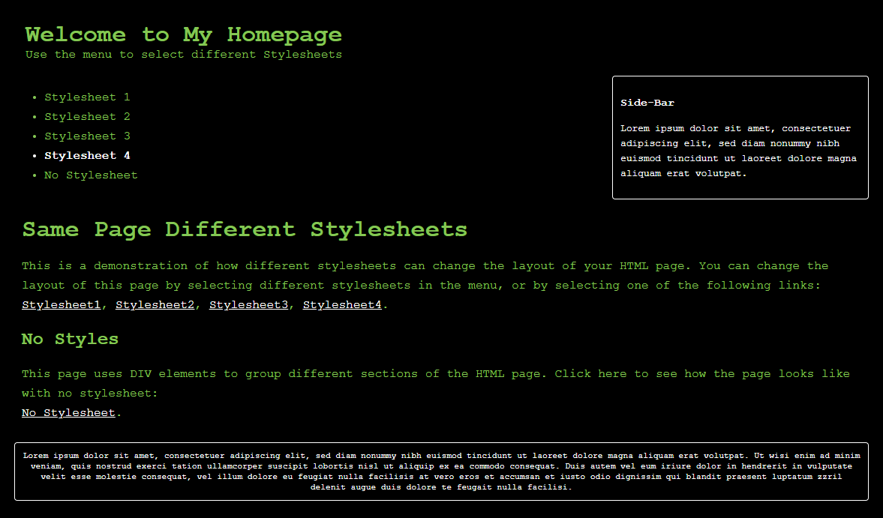
Sample Webpage Styled with CSS

Slide 92
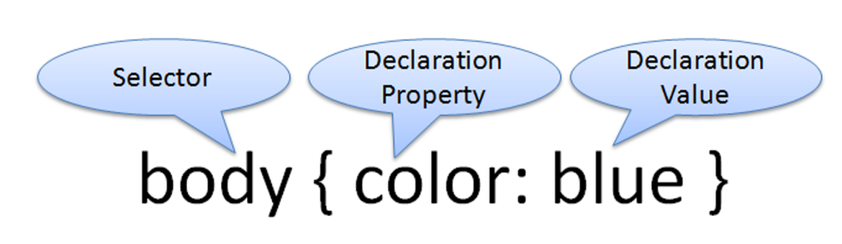
CSS – So how does it work?
The rules that describe the styling to be applied are made up of two parts
Selectors
Declarations
We choose the element to be styled by entering it is the Selector field.
The example below shows the entire body section being chosen.
We then choose the property and value to be applied to it.
The example shows the property: color being chosen and the value: blue being applied to it.
 Note: Pay attention to the spelling of the word color when using it.

Slide 93
CSS – How do we use it?
In this class we will look at Inline Styling and how to implement it.
The syntax (arrangement of the various parts), for inline styling is shown below.
When using Inline Styling, we add the styling directly to the opening HTML tag itself, so it is specifically applied to the content of that tag and that tag only.
If any styling had been applied before this, we would be over-riding it by applying this inline styling.
<p style="color: blue; font-size: 46px;">
In this example we are:
Styling a paragraph element
Colouring it blue
Changing the font size to 46 pixels

Slide 94
CSS – How do we use it?
<p style="color: blue; font-size: 46px;"> Insert content here </p>
The code displayed above shows the full element containing the opening HTML tag (with inline CSS styling applied), the content and the closing tag.
The styling is applied in the opening tag only and multiple style attributes are separated by semi-commas.

Slide 95
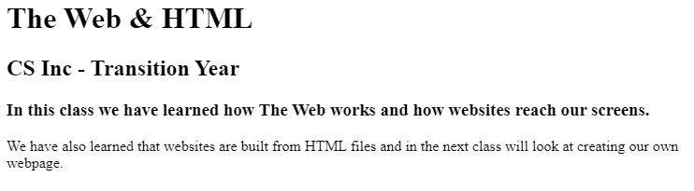
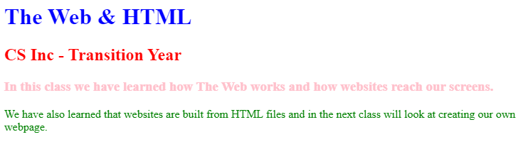
Inline Styling
In this class, we will only use inline styling to make changes to our HTML documents.
We will look at external style sheets in the next class.
To look at Inline Styling in action, in more than one element, we will use the basic HTML code from Class 1 – Task 2 and change the text colour
From this:
To this:

Slide 96
Inline Styling
We will use the code below to apply some inline styling
Before moving on, what four items do we need to apply the styling to?
<!DOCTYPEhtml>
<html>
<head>
<metacharset="utf-8">
<metaname="viewport"content="width=device-width">
<title>The Web & HTML</title>
<linkhref="style.css"rel="stylesheet"type="text/css"/>
</head>
<body>
<scriptsrc="script.js"></script>
<h1>The Web & HTML </h1>
<h2>CS Inc - Transition Year </h2>
<h3>In this class we have learned how The Web works and how websites reach our screens.</h3>
<p>We have also learned that websites are built from HTML files and in the next class will look at creating our own webpage. </p>
</body>
</html>

Slide 97
Inline Styling
To change the colours to match the example we need to add inline styling to the
<h1>
<h2>
<h3>
and second <p> element (shown below).
<h1>The Web & HTML </h1>
<h2>CS Inc - Transition Year </h2>
<h3>In this class we have learned how The Web works and how websites reach our screens.</h3>
<p>We have also learned that websites are built from HTML files and in the next class will look at creating our own webpage. </p>
</body>
</html>

Slide 98
Inline Styling
Elements to style:
<h1>
<h2>
<h3>
and second <p> element.
<h1>The Web & HTML </h1>
<h2>CS Inc - Transition Year </h2>
<h3>In this class we have learned how The Web works and how websites reach our screens.</h3>
<p>We have also learned that websites are built from HTML files and in the next class will look at creating our own webpage. </p>
</body>
</html>

Slide 99
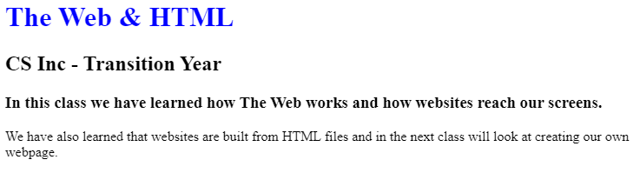
Inline Styling
Elements to style:
<h1 style=“color:blue;”>
<h2>
<h3>
<p>
<h1 style="color:blue">The Web & HTML </h1>
<h2>CS Inc - Transition Year </h2>
<h3>In this class we have learned how The Web works and how websites reach our screens.</h3>
<p>We have also learned that websites are built from HTML files and in the next class will look at creating our own webpage. </p>
</body>
</html>

Slide 100
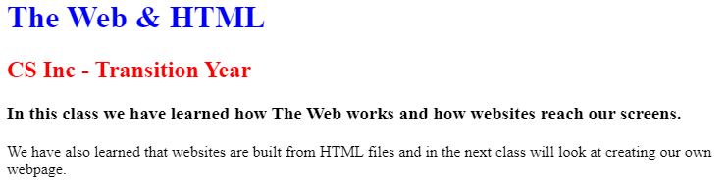
Inline Styling
Elements to style:
<h1 style=“color:blue;”>
<h2 style=“color:red;”>
<h3>
<p>
<h1 style="color:blue">The Web & HTML </h1>
<h2 style="color:red;">CS Inc - Transition Year </h2>
<h3>In this class we have learned how The Web works and how websites reach our screens.</h3>
<p>We have also learned that websites are built from HTML files and in the next class will look at creating our own webpage. </p>
</body>
</html>

Slide 101
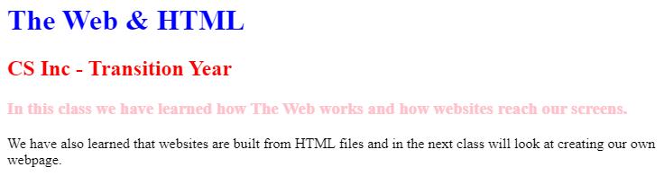
Inline Styling
Elements to style:
<h1 style=“color:blue;”>
<h2 style=“color:red;”>
<h3 style=“color:pink;”>
<p>
<h1 style="color:blue">The Web & HTML </h1>
<h2 style="color:red;">CS Inc - Transition Year </h2>
<h3 style="color:pink;">In this class we have learned how The Web works and how websites reach our screens.
</h3>
<p>We have also learned that websites are built from HTML files and in the next class will look at creating our own webpage. </p>
</body>
</html>

Slide 102
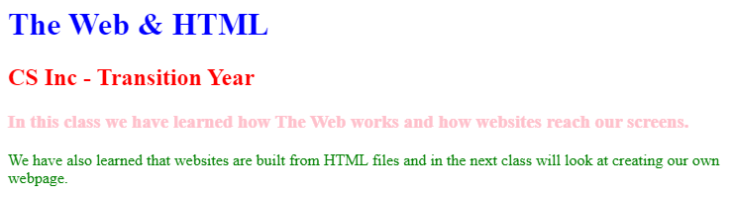
Inline Styling
Elements to style:
<h1 style=“color:blue;”>
<h2 style=“color:red;”>
<h3 style=“color:pink;”>
<p style=“color:green;”>
<h1 style="color:blue">The Web & HTML </h1>
<h2 style="color:red;">CS Inc - Transition Year </h2>
<h3 style="color:pink;">In this class we have learned how The Web works and how websites reach our screens.</h3>
<p style ="color:green;">We have also learned that websites are built from HTML files and in the next class will look at creating our own webpage. </p>
</body>
</html>

Slide 103
The Web What’s next?
What is it and how does it work?
The Internet. World Wide Web. Client / Server relationships
How are websites made?
Intro to HTML
HTML
The language of the web
CSS
Styling websites
Embedding code within webpages
Bootstrap
Another method to style websites
Assessment
Class 1
Classes 2 & 3
Classes 4 & 5
Class 6
Class 7
Class 8

Slide 104
Summary
You are now familiar with
What CSS is used for
Using inline styling to change the colour of text on a webpage

Slide 106
The Web What will we cover in these classes?
What is it and how does it work?
The Internet. World Wide Web. Client / Server relationships
How are websites made?
Intro to HTML
HTML
The language of the web
CSS
Styling websites
Embedding code within webpages
Bootstrap
Another method to style websites
Assessment
Class 1
Classes 2 & 3
Classes 4 & 5
Class 6
Class 7
Class 8

Slide 107
Review: What did we cover in the last class?
CSS
What is it?
What does it do?
How do we use it?
Inline Styling
Styling individual elements

Slide 108
What will we cover in this class?
External Style Sheets
Their benefits over Inline Styling
How they work
How to use them
Navigation Bar
How important they are for good UX
How to implement them within our HTML pages.

Slide 109
CSS – External Style Sheets
In the last class we saw how we can style individual HTML elements to change their colour, font, font size, positioning, etc.
If we wanted to style 100 elements using inline styling, we would need to insert the CSS inline style coding 100 times in 100 different locations.
Keeping track of where the changes would be needed would be a job in itself.
This is where External Style Sheets come in to make life much easier when styling entire websites. One change within an external style sheet can affect the 100 elements throughout the website in one go. This makes it a much more efficient way to manage the styling of a website.
So how do they work?

Slide 110
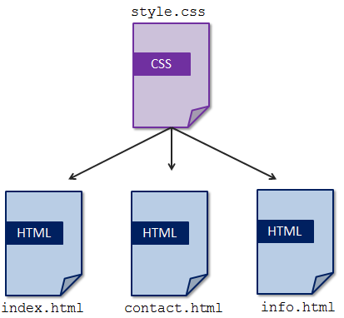
CSS – External Style Sheets
Instead of adding code within the individual elements of our website, an external style sheet file is used to store all of the various stylings for each section of the HTML document.
There are many benefits to this approach:
It makes the HTML document easier to read as there is less code to read.
It is a more efficient way of making changes to multiple webpages throughout a website.
It allows for larger websites to be maintained more easily.
The speed of the pages loading increases once the stylesheet has been loaded to memory.

Slide 111
CSS – External Style Sheets
Remember when we said to forget the style.css file in Class 1 until a later class?
Stop forgetting it. It’s time to look at it now!
In the <head> section of our HTML document we have seen the code below appearing each time we load up a new session.
<link href="style.css" rel="stylesheet" type="text/css" />
This line of code shows the HTML document linking to the external style sheet "style.css"
Once this is in place (and a style.css file exists) we can focus on building:
the structure within the various .html files
the styling for them within the .css file.
Note: The file can be called whatever you want provided it has .css after it. style.css is what we will use in these classes.

Slide 112
CSS – External Style Sheets
External style sheets should contain styling for each element of the HTML files that you wish to style
body { background-color: lightblue; } h1 { color: navy; margin-left: 20px; }
In the example above, the style sheet contains styling for the <body> and <h1> sections.
The background of all webpages that are linked to this style sheet will be light blue and
The <h1> headings will have navy text with a margin from the left of 20 pixels.
You must ensure that the attributes you want to style are contained { within the brackets }

Slide 113
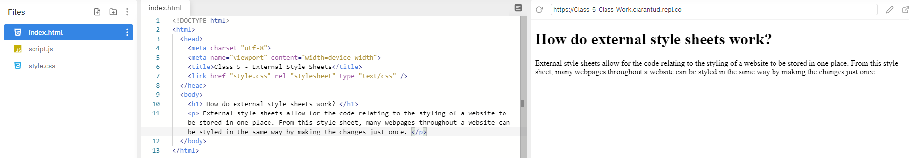
CSS – External Style Sheets
No styling entered in the style.css file:

Slide 114
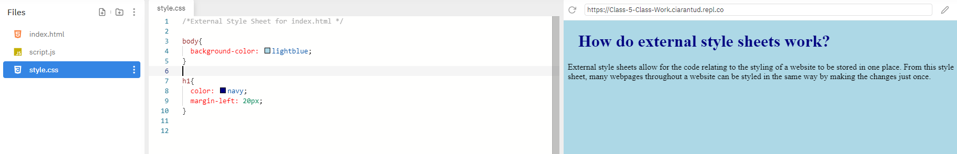
CSS – External Style Sheets
The styling from our previous example is entered in the style.css file:
The background colour is light blue
The heading colour is navy
The heading is moved in from the left

Slide 115
CSS – Navigation between pages
What have we covered so far?
We can create webpages using HTML containing text, images and links to make websites.
We can style these webpages using CSS, whether it is within each element or from an external style sheet.
What we need now is a way to navigate between these webpages easily.
That is where nav bars come in.

Slide 116
CSS – Navigation Bars
We need to add a new section to our HTML documents to use a nav bar.
It needs to be added to all webpages that you want it to appear on.
In the body section we will add the code below:
<nav>
<a href="index.html">Page1</a>
<a href="page2.html">Page2</a>
<a href="page3.html">Page3</a>
<a href="page4.html">Page4</a>
</nav>
In the new <nav> section, we have four anchor links with each one linking to a different webpage.
The text before the closing tag (Page1, Page2, Page3, Page4 in our example) is what will appear in the nav bar on screen.
Let’s see what it all looks like in action.

Slide 117
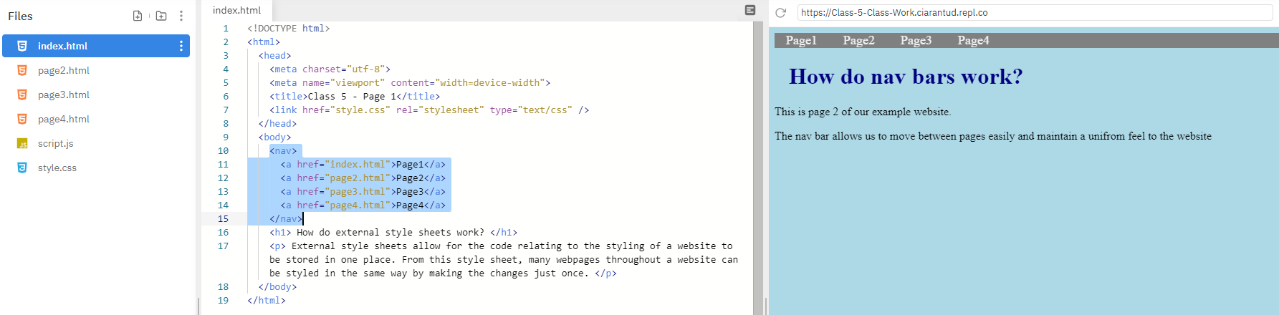
CSS – Navigation Bars
We have added three new .html files for the new webpages (page2.html, page3.html & page4.html).
Each page is linked correctly within the nav section.
We can see a basic nav bar at the top of each webpage to allow us reach each page.
 Note: The CSS for the nav section is on the next slide.

Slide 118
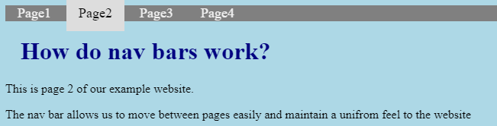
CSS – Navigation Bars
/* Add a grey background colour to the top nav bar */
nav{
background-color: grey;
}
/* Style the links inside the nav bar */
nav a {
float: top;
color: #f2f2f2;
text-align: center;
padding: 14px 16px;
text-decoration: none;
font-size: 18px;
}
/* Change the colour of links on hover */
nav a:hover {
background-color: #ddd;
color: black;
}
/* Add a grey background colour to the top nav bar */
This code dictates the colour applied to the entire nav bar.
/* Style the links inside the nav bar */
This code affects the individual nav buttons
It fixes it at the top of the screen, centrally aligned and coloured a light grey.
There is some padding used to space them more evenly and the font size is slightly smaller than the header font size at 18px
/* Change the colour of links on hover */
This code affects what happens when the mouse cursor moves over each nav button.
When the cursor moves over each button, it changes the background colour to a lighter grey and changes the text colour to black.

Slide 119
Summary
You are now familiar with
Adding styling in an external css file
Linking to an external css file
Creating a navigation bar with HTML and styling it with CSS

Slide 121
Web Design & Development What will we cover in these classes?
What is ‘The Web’ and how does it work?
The Internet. World Wide Web. Client / Server relationships
How are websites made?
Intro to HTML
HTML
The language of the web
CSS
Styling websites
Building a Classwork Portfolio Website
Bootstrap
Another method to style websites
Assessment
Class 1
Classes 2 & 3
Classes 4 & 5
Class 6
Class 7
Class 8

Slide 122
Review: What did we cover in the last classes?
CSS What is it? What does it do? How does it work? What can we change? What does it look like? | CSS Navigation Bars Moving between pages of a website
Using CSS Elements Syntax Selectors Ways to implement CSS | External Style Sheets Styling entire websites

Slide 123
What will we cover in this class?
Using everything we have covered in the last 5 classes, we will build a website to store our work from this module and from the other modules in the CS Inc course.
Each subject will have it’s own page and there will be a navigation bar linking them all.
We will also look at embedding code used in the Micro:Bit module within a webpage so that it appears as it would on a physical device.

Slide 124
What will we cover in this class?
The work completed during this lesson will act as Task 1.
Using a second external style sheet, Task 2 will be to style the website completely differently to how we style it during this lesson.
Note: You are encouraged to style it to your own liking and be as adventurous as you want.
Task 3 will be to add a CV page to the website containing information about you and your experience.

Slide 125
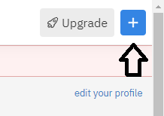
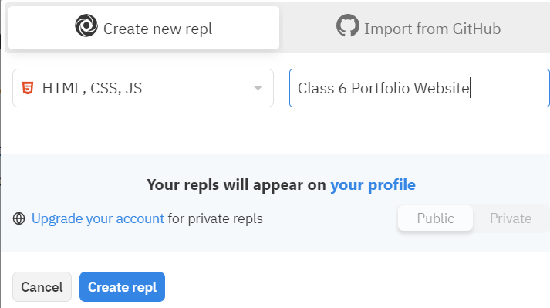
Set up a new Repl session for the task
Open www.repl.it
Click Log In
Enter username and password
Click Log In
Click New Repl in the top right of the screen
Select HTML, CSS, JS as language
Name the Repl session as “Class 6 Portfolio Website”
Click Create Repl

Slide 126
Building a Portfolio Website - Planning
How many pages does our website require?
Homepage
Python
Web Design & Development
Micro:Bit
Intro to Computer Science
What elements will the pages require?
Nav
Body
Headings
Paragraphs
Images
What resources will each page be displaying?
Text
Code
Images
This list will vary, depending on the modules you have completed in your school or centre

Slide 127

Setting up the project
We need to add additional HTML files to cover the pages required. This will vary depending on the modules that you have completed in your school or centre
python.html
webdev.html
compsci.html
microbit.html
We also need to add an Images folder.
images

Slide 128
Homepage
If we get the nav bar set up first in the index.html file, then we can copy the code and paste it in to the other pages to use as the starting point.
Add a <nav> section.
Add anchor links within it.
The links should point to each HTML file.
This ensures that we can reach any page of the website, from any page of the website.
<body>
<script src="script.js"></script>
<nav>
<a href="index.html">Home</a>
<a href="compsci.html">Computer Science</a>
<a href="microbit.html">Micro:Bit</a>
<a href="python.html">Python</a>
<a href="webdev.html">Web Development</a>
</nav>
</body>
This code is available on Moodle if you want to copy it into index.html

Slide 129
Homepage
Before we copy the base code to the other pages, let’s apply some basic styling.
We’ll stick with a light blue background and grey navigation bar as in the other tasks
nav {
background-color: grey;
}
nav a {
float: top;
color: #f2f2f2;
text-align: center;
padding: 14px 16px;
text-decoration: none;
font-size: 18px;
}
nav a:hover {
background-color: #ddd;
color: black;
}
body {
background-color: lightblue;
}
This code is available on Moodle if you want to copy it into style.css

Slide 130

Webpages
Copy the code from index.html and paste it into each of the other HTML files.
Click Run and you should be able to click on each link and reach that page.
If you encounter any errors, check the spelling and look out for capital letters where there shouldn’t be any.
We also need the CS Inc logo to appear on the pages so move the .jpeg file into the images folder now.

Slide 131

Homepage
Add an image, headings and two paragraphs to the index.html page
Image - CS Inc logo
Heading 1 – “CS Inc Website Portfolio”
Heading 3 – “Your Name”
Paragraph – “I have built this website to showcase the work I have completed during the CS Inc modules. I have learned programming in Python, Web Design and Development, programming a Micro:Bit and received an Introduction to Computer Science.”
Paragraph – “You will find some of the tasks I have completed on each page. I hope you enjoy what you see.”

Slide 132

Homepage
In the style.css external style sheet, add styling to each new element
img {
width: 100%
}
h1 {
color:navy;
text-align: center;
}
h3 {
color: navy;
text-align:center;
}
p {
color: navy;
}

Slide 133
Building the individual lesson pages
The next step is to fill each lesson page with content detailing all you have accomplished.
 Note: Don’t use the text in these slides. You should add as much information about all you have learned as you can.
To do this we need to add HTML elements to each module page documenting what you have learned.
You can add more entries to the external style sheet or use inline styling if required to style the pages as you want.
You should outline some of the tasks you have completed and insert some images.
Hint: Perhaps show a before (start of the task) and after (when it is complete).
As an example, we will work on the Micro:Bit webpage and look at embedding code within a webpage so you can demonstrate your work from that class.

Slide 134
Building the individual lesson pages
Click on the microbit.html file in Repl
Add in some text detailing what you have learned and completed throughout the module.
The code below is a sample.
<h2>
Micro:Bit
</h2>
<p>
In this module we learned how to program a Micro:Bit device to produce a physical response to our coding using the lights and sounds available on it.
</p>

Slide 135
Embedding code
Next, we will use a new tag to embed the code used in the Micro:Bit module into our webpage.
You can export one of your own Micro:Bit tasks or follow the steps below to embed the code.
Below the <p> elements you just entered, enter the code below:
<p>
In our Web Design & Development we learned how to embed code within a webpage and you can see a task we completed on our Micro:Bit embedded into the webpage here.
</p>

Slide 136

Embedding code
Next, we will use a new tag to embed the code used in the Micro:Bit module into our webpage.
You can export one of your own Micro:Bit tasks or follow the steps below to embed the code.
Open up one of your Micro:Bit projects.
Click on Share
Click on Publish Project

Slide 137

Embedding code
Click on Embed
Click on Simulator
Highlight and Copy all of the code that appears in the next screen (or click on Copy button)

Slide 138
Embedding code
Click on Embed.
Click on Simulator.
Highlight and Copy all of the code that appears in the next screen (or click on Copy button).
Open up the microbit.html page in Repl and paste the code into the body section below your text.
Click Run and click on the link for the Micro:Bit page in the nav bar.
You should see the webpage load like the image on the next slide.
It should be fully interactable, showing off the code you created in action

Slide 139

Micro:Bit embedded on the webpage

Slide 140
Embedding code
If you didn’t add a h2 element to the style.css file when you loaded the page and saw that it was different to the rest of the text, do so now.
You can have it appear like the h1 or h3 elements or you can try something new.
h2 {
color: navy;
text-align: left;
}
A completed example is shown on the next slide. Please continue to add content in the same way to the Web Design & Development, Python and Computer Science module pages.
Text
Images
Whatever you like.

Slide 141


Completed Homepage & Micro:Bit page

Slide 142
Summary
You have now seen how to set up a website with separate webpages for each of the modules you are completing in your school or centre
You can now complete your website by updating the other webpages to give details of what you have learned

Slide 144
Web Design & Development What will we cover in these classes?
What is ‘The Web’ and how does it work?
The Internet. World Wide Web. Client / Server relationships
How are websites made?
Intro to HTML
HTML
The language of the web
CSS
Styling websites
Building a Classwork Portfolio Website.
Bootstrap
Another method to style websites
Assessment
Class 1
Classes 2 & 3
Classes 4 & 5
Class 6
Class 7
Class 8

Slide 145
Review: What did we cover in the classes so far?
HTML The structure of webpages Using tags and elements Linking between pages Linking to external websites Using lists | Images Images folder Proper use of the source attribute to reference and link to the relevant image file
CSS How to make the HTML pages look nice Implementing colour and design | Embedding code Bringing code from external projects and embedding it into our webpages Bringing dynamic activity to our website

Slide 146
What will we cover in this class?
Bootstrap
What is it?
Pros & Cons
How do we use it?
What does it look like?
How to implement Bootstrap
Using Bootstrap
Grid
Colours
Buttons
Hamburger Nav Bar

Slide 147
Bootstrap – What is it?
Bootstrap is a free and Open-Source CSS framework.
It is aimed at ‘mobile – first’ front end web development.
It was originally developed in 2011 by Mark Otto and Jacob Thornton in Twitter to promote consistency across the internal tools used in Twitter
Mark Otto:
It has since spread further than the Twitter offices and is used on 21% of all websites, including the likes of Netflix.com
https://w3techs.com/technologies/details/js-bootstrap#:~:text=Bootstrap%20is%20used%20by%2027.0,an%20extensive%20Bootstrap%20market%20report
“A super small group of developers and I got together to design and build a new internal tool and saw an opportunity to do something more. Through that process, we saw ourselves build something much more substantial than another internal tool. Months later, we ended up with an early version of Bootstrap as a way to document and share common design patterns and assets within the company.”

Slide 148
Bootstrap – Pros & Cons
Pros
It’s free.
Will ensure uniformity in design.
Allows for easy development of responsive websites.
Promotes mobile-first, responsive, development.
Cons
Your website design will appear similar to hundreds of thousands (possibly millions) of other websites.
There is some difference in how things are named compared to CSS so it is not as easy to jump into using.

Slide 149
Bootstrap – How do we use it?
To implement Bootstrap CSS styling in our website we just need to link to the Bootstrap CSS Stylesheet. This is done in the same way as we have done in previous classes.
We will include the link shown below in our HTML document.
 Note: This link is saved in a text file on moodle and you can copy and paste it when you need it
<link rel="stylesheet" href="https://stackpath.bootstrapcdn.com/bootstrap/4.3.1/css/bootstrap.min.css" integrity="sha384-ggOyR0iXCbMQv3Xipma34MD+dH/1fQ784/j6cY/iJTQUOhcWr7x9JvoRxT2MZw1T" crossorigin="anonymous">

Slide 150
Bootstrap – Some things to know
The logic in how we applied CSS to our HTML documents will transfer over to Bootstrap.
We will use ‘inline styling’ for this class and style specific aspects of the webpages as we want. External stylesheets can also be used.
However, the names of buttons, page sections and colours in Bootstrap are different to what we have encountered so far.
Let’s look at what some examples can look like before we start using it.

Slide 151

Sample Webpage styled with Bootstrap
Credit: https://www.taniarascia.com/what-is-bootstrap-and-how-do-i-use-it/

Slide 152

Another Webpage styled with Bootstrap
Credit: https://www.taniarascia.com/what-is-bootstrap-and-how-do-i-use-it/

Slide 153

Another Webpage styled with Bootstrap
Credit: https://www.taniarascia.com/what-is-bootstrap-and-how-do-i-use-it/

Slide 154

Bootstrap – The Grid
One notable difference in the Bootstrap framework to CSS is the Grid. It is the basis on which the entire page layout is created.
Each page is made up of rows. You can have as many rows on the page as you want or need.
Each row is made up columns. The combined column width per row is 12.
Note: You can have fewer than 12. You can’t have more!
The examples below shows the layout of these 3 rows
The first has one column of width 8 and a second column of width 4 (8 + 4 = 12)
The second has three columns of width 4 (4 + 4 + 4 = 12)
The third has one column of width 6 and a second column of width 6 (6 + 6 = 12)
Credit: https://www.taniarascia.com/what-is-bootstrap-and-how-do-i-use-it/

Slide 155
Bootstrap – The Grid
If we look at our examples from the previous slides, you can see how they are made up of rows and columns
Two rows
First row – One column
Second row – Three columns
Going further into detail on this is out of the scope of this class but it is useful to bear in mind when arranging your pages.
Credit: https://www.taniarascia.com/what-is-bootstrap-and-how-do-i-use-it/

Slide 156
Bootstrap – Responsive Design
Let’s look at responsive design in action.
Open www.repl.it
Click Log In
Enter username and password
Click Log In
Click on the + on the top right of the screen
Select HTML, CSS, JS as language
Name the Repl session as “Class 7 Test”
Click Create Repl

Slide 157
Bootstrap – Responsive Design
Add the Bootstrap stylesheet URL to the <head> element of your index.html document
<link rel="stylesheet“ href="https://stackpath.bootstrapcdn.com/bootstrap/4.3.1/css/bootstrap.min.css" integrity="sha384-ggOyR0iXCbMQv3Xipma34MD+dH/1fQ784/j6cY/iJTQUOhcWr7x9JvoRxT2MZw1T" crossorigin="anonymous">
The code below is available on moodle. Copy and paste it into your <body> section
<div class="row">​
<div class="col-md-3">First column</div>​
<div class="col-md-3">Second column</div>​
<div class="col-md-3">Third column</div>​
<div class="col-md-3">Fourth column</div>​
</div>​
<div class="row">​
<div class="col-xs-12 col-md-3">.col-xs-12 .col-md-3</div>​
<div class="col-xs-12 col-md-3">.col-xs-12 .col-md-3</div>​
<div class="col-xs-12 col-md-3">.col-xs-12 .col-md-3</div>​
<div class="col-xs-12 col-md-3">.col-xs-12 .col-md-3</div>​
</div>​
Click Run
Move the column to the right to make the preview window smaller and see what happens.

Slide 158


Bootstrap – Responsive Design
Before: After:
We can see that on devices with smaller screens (phones & tablets) or when browser windows are made smaller, the content on the page is moved accordingly so that it is always presented to the user and nothing is pushed out of view.

Slide 159

Bootstrap – Colours
I’m sure you could all name these colours, right? Let’s see if you and Bootstrap agree.

Slide 160
Bootstrap – Colours
Were you right?
bg-primary
bg-success
As you can see, it is not simply a case of typing in green, yellow or red.
Note: The bg- in each section refers to the ‘background’.
The rest of the text refers to the colour you wish to use.
You can refer to the Bootstrap cheatsheet in Moodle if you find yourself forgetting that green = success when completing the tasks
bg-info
bg-warning
bg-danger
bg-secondary
bg-dark

Slide 161

Bootstrap – Buttons
Bootstrap buttons are an easy way to bring some nice design to your website.
They can be used to turn a plain hyperlink into an eye catching button to help attract the user’s attention.
The code below is available on Moodle. Copy and paste it into the <body> section of Class 7 Test session below the grid code if you wish to try this out.
<h2>Button Styles</h2>
<button type="button" class="btn">Basic</button>
<button type="button" class="btn btn-primary">Primary</button>
<button type="button" class="btn btn-secondary">Secondary</button>
<button type="button" class="btn btn-success">Success</button>
<button type="button" class="btn btn-info">Info</button>
<button type="button" class="btn btn-warning">Warning</button>
<button type="button" class="btn btn-danger">Danger</button>
<button type="button" class="btn btn-dark">Dark</button>
</h2>
Click Run and you should see the following in the preview pane:

Slide 162
Bootstrap – Hamburger Nav Bar
Bootstrap allows us to also change the appearance of our nav bars as another useful way to bring some nice design to your website.
They can be used to condense the nav bar options on smaller screen into a list which appears when the Hamburger menu icon is clicked or tapped.
The code on the next page is available on Moodle. Use it to replace all of the code in the Class 7 Test Repl session.
Click Run and you should see the image shown after the code.

Slide 163
Bootstrap – Hamburger Nav Bar
<!DOCTYPE html> <html> <head> <title>Class 7 - Bootstrap</title> <link rel="stylesheet“ href="https://maxcdn.bootstrapcdn.com/bootstrap/4.5.2/css/bootstrap.min.css"> </head> <body> <nav class="navbar navbar-expand-md bg-dark navbar-dark"> <a class="navbar-brand" href="#">Navbar</a> <button class="navbar-toggler" type="button" data-toggle="collapse" data-target="#collapsibleNavbar"> <span class="navbar-toggler-icon"></span> </button> <div class="collapse navbar-collapse" id="collapsibleNavbar"> <ul class="navbar-nav"> <li class="nav-item"> <a class="nav-link" href="#">Link 1</a></li> <li class="nav-item"><a class="nav-link" href="#">Link 2</a></li> <li class="nav-item"> <a class="nav-link" href="#">Link 3</a></li> </ul> </div> </nav> | <h2>Button Styles</h2> <div class="row"> <div class="col-md-3"><button type="button" class="btn">Basic</button></div> <div class="col-md-3"><button type="button" class="btn btn-primary">Primary</button></div> <div class="col-md-3"><button type="button" class="btn btn-secondary">Secondary</button></div> <div class="col-md-3"><button type="button" class="btn btn-success">Success</button></div> </div> <div class="row"> <div class="col-xs-12 col-md-3"><button type="button" class="btn btn-info">Info</button></div> <div class="col-xs-12 col-md-3"><button type="button" class="btn btn-warning">Warning</button></div> <div class="col-xs-12 col-md-3"><button type="button" class="btn btn-danger">Danger</button></div> <div class="col-xs-12 col-md-3"><button type="button" class="btn btn-dark">Dark</button></div> </div></body> <script src="https://ajax.googleapis.com/ajax/libs/jquery/3.5.1/jquery.min.js"></script> <script src="https://cdnjs.cloudflare.com/ajax/libs/popper.js/1.16.0/umd/popper.min.js"></script> <script src="https://maxcdn.bootstrapcdn.com/bootstrap/4.5.2/js/bootstrap.min.js"></script> </html>

Slide 164

Bootstrap – Hamburger Nav Bar
Webpage is expanded enough to show the full nav bar.
Reduce the size of the screen.
See what happens to the nav bar.

Slide 165


Bootstrap – Hamburger Nav Bar
When the webpage is reduced in size, the full nav bar links disappear and the menu button appears.
When we click on the menu button, we can see the links appear.

Slide 166
Bootstrap
Now that we know what Bootstrap looks like, let’s use it on some of our webpages by completing some of the Tasks on Moodle.
Refer to the Bootstrap ‘Cheat Sheet’ on Moodle at any point if you need it and check out the resources at w3schools.com at the link below for a deeper look into what Bootstrap can offer you.
https://www.w3schools.com/bootstrap4/default.asp

Slide 167
Summary
You are now familiar with
What bootstrap is and it's Pros and Cons
How to include the bootstrap stylesheet in your HTML
How to use the bootstrap stylesheet to produce responsive design for your web pages

Slide 170

Bootstrap – The Grid
Each page is made up of rows. You can have as many rows on the page as you want or need.
Each row is made up columns. The combined column width per row is 12.
You can have less than 12.
You can’t have more.
The examples below show 3 rows
The first has one column of width 8 and a second column of width 4 (8 + 4 = 12)
The second has three columns of width 4 (4 + 4 + 4 = 12)
The third has one column of width 6 and a second column of width 6 (6 + 6 = 12)
Credit: https://www.taniarascia.com/what-is-bootstrap-and-how-do-i-use-it/

Slide 171
Bootstrap – The Grid
If we look at our examples from the previous slides, you can see how they are made up of rows and columns
Two rows
First row – One column
Second row – Three columns
Going further into detail on this is out of the scope of this class but it is useful to bear in mind when arranging your pages.
Credit: https://www.taniarascia.com/what-is-bootstrap-and-how-do-i-use-it/

Slide 172
Bootstrap – Responsive Columns
Add the Bootstrap stylesheet URL to the index.html document
<link rel="stylesheet“ href="https://stackpath.bootstrapcdn.com/bootstrap/4.3.1/css/bootstrap.min.css" integrity="sha384-ggOyR0iXCbMQv3Xipma34MD+dH/1fQ784/j6cY/iJTQUOhcWr7x9JvoRxT2MZw1T" crossorigin="anonymous">
Column sizes per device type.
<div class="row">
<div class="col-">Devices < 576px (Smaller SmartPhones)</div>
<div class="col-sm">Devices >= 576px (SmartPhones)</div>
<div class="col-md">Devices >= 768px (Tablets)</div>
<div class="col-lg">Devices >= 992px (Laptops)</div>
<div class="col-xl”>Devices >= 1200px (Desktops)</div>
</div>

Slide 173


Bootstrap – How to reference elements
Element: Code: Example:
Rows: <div class=“row”>
Columns: <div class=“col”>
Buttons: <button type=“button” class=“btn btn-warning”>Warning</button>
Background: <div class=“p-2 mb-2 bg-success text-white”> .bg-success</div>
Text: <p class=“text-primary”>.text-primary</p>

Slide 174
Bootstrap – Colours
bg-primary
bg-success
bg-info
bg-warning
bg-danger
bg-secondary
bg-dark

Slide 175
Bootstrap – Cards
<div class="card">
<img class="card-img-top" src="/images/pathToYourImage.png/jpg" alt=“Alternate Text For Image">
<div class="card-body">
<h4 class="card-title">Card title</h4>
<p class="card-text">
Some quick example text to build on the card title
and make up the bulk of the card's content.
</p>
<a href="#" class="btn btn-primary">You can define a link to bring you somewhere if required</a>
</div>
</div>

Slide 176
Bootstrap – Buttons
Bootstrap buttons are an easy way to bring some nice design to your website.
They can be used to turn a plain hyperlink into an eye catching button to help attract the user’s attention.
Copy the code below and paste it into the <body> section of the Task 1 Repl session below the grid code.
<h2>Button Styles</h2>
<button type="button" class="btn">Basic</button>
<button type="button" class="btn btn-primary">Primary</button>
<button type="button" class="btn btn-secondary">Secondary</button>
<button type="button" class="btn btn-success">Success</button>
<button type="button" class="btn btn-info">Info</button>
<button type="button" class="btn btn-warning">Warning</button>
<button type="button" class="btn btn-danger">Danger</button>
button type="button" class="btn btn-dark">Dark</button>
</h2>

Slide 177
Bootstrap – Hamburger Nav Bar - Template
<!DOCTYPE html>
<html>
<head>
<meta charset="utf-8">
<meta name="viewport" content="width=device-width">
<title>Class 7 - Bootstrap</title>
<link rel="stylesheet" href="https://maxcdn.bootstrapcdn.com/bootstrap/4.5.2/css/bootstrap.min.css">
</head>
<body>
<nav class="navbar navbar-expand-md bg-dark navbar-dark">
<!-- Brand -->
<a class="navbar-brand" href="#">Navbar</a>
<!-- Toggler/collapsibe Button -->
<button class="navbar-toggler" type="button" data-toggle="collapse" data-target="#collapsibleNavbar">
<span class="navbar-toggler-icon"></span>
</button>
<!-- Navbar links -->
<div class="collapse navbar-collapse" id="collapsibleNavbar">
<ul class="navbar-nav">
<li class="nav-item">
<a class="nav-link" href="#">Link 1</a>
</li>
<li class="nav-item">
<a class="nav-link" href="#">Link 2</a>
</li>
<li class="nav-item">
<a class="nav-link" href="#">Link 3</a>
</li>
</ul>
</div>
</nav>
<script src="https://ajax.googleapis.com/ajax/libs/jquery/3.5.1/jquery.min.js"></script>
<script src="https://cdnjs.cloudflare.com/ajax/libs/popper.js/1.16.0/umd/popper.min.js"></script>
<script src="https://maxcdn.bootstrapcdn.com/bootstrap/4.5.2/js/bootstrap.min.js"></script>
</body>
</html>

Slide 178
Bootstrap – Useful Links
https://www.w3schools.com/bootstrap4/default.asp
https://hackerthemes.com/bootstrap-cheatsheet/
https://bootstrapcreative.com/resources/bootstrap-4-css-classes-index/

